Slide 1

LVMH
MUSEACO
MUSIC x EASY x COLLAB
DATA-DRIVEN SYNERGY FOR PERFECT BRAND-ARTIST COLLABORATIONS
TEAM 03
Vinayak SINGH, Sai PAWAR, Sakshi THOKE, Jaturaporn NUSATI, Daniel DE PAULA, Haotian ZHENG

Slide 2


LVMH
VINAYAK
A brand communication manager at Louis Vuitton
who wants to find a musical artist to collaborate with the brand

Slide 3
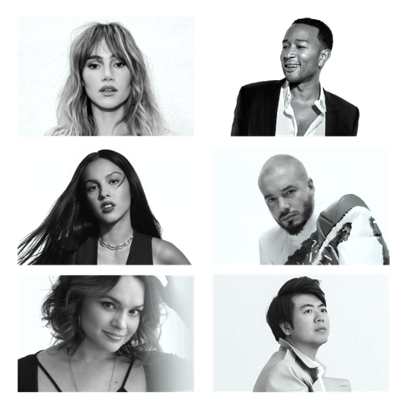
BARRIERS
What hinders him from achieving maximum efficiency:
Lack of a centralized system that maps the artists and celebrities to suitable maisons
Wrong identification of the target segment, making the collaboration doesn’t create an effective image in the minds of consumers

Slide 4
SOLUTION
Data-driven synergy for perfect brand-artist collaborations
MUSEACO
MUSIC x EASY x COLLAB
A platform for artist selection and a webpage for sending collaboration requests.

Slide 5
FRAMEWORK
A framework that will facilitate the manager:
Artist
Selection
Selected Artist
Artist as a Recommendation
Artist Contract Management
Develop a pool of artists
Optimize artist pool
Authorized Contract
Manage Artist Performance
Maturity Development Request
Artist Contract Request
Contract Negotiation
Market Returns
KPI Metrics
Staistical data
Manage Artist Maturity
Corrective Action Plan (CAP)

Slide 6
ARTIST SELECTION
1
New-to-the-maison Artists
2
Artist with specific values
3
Past collaboration Artists

Slide 7
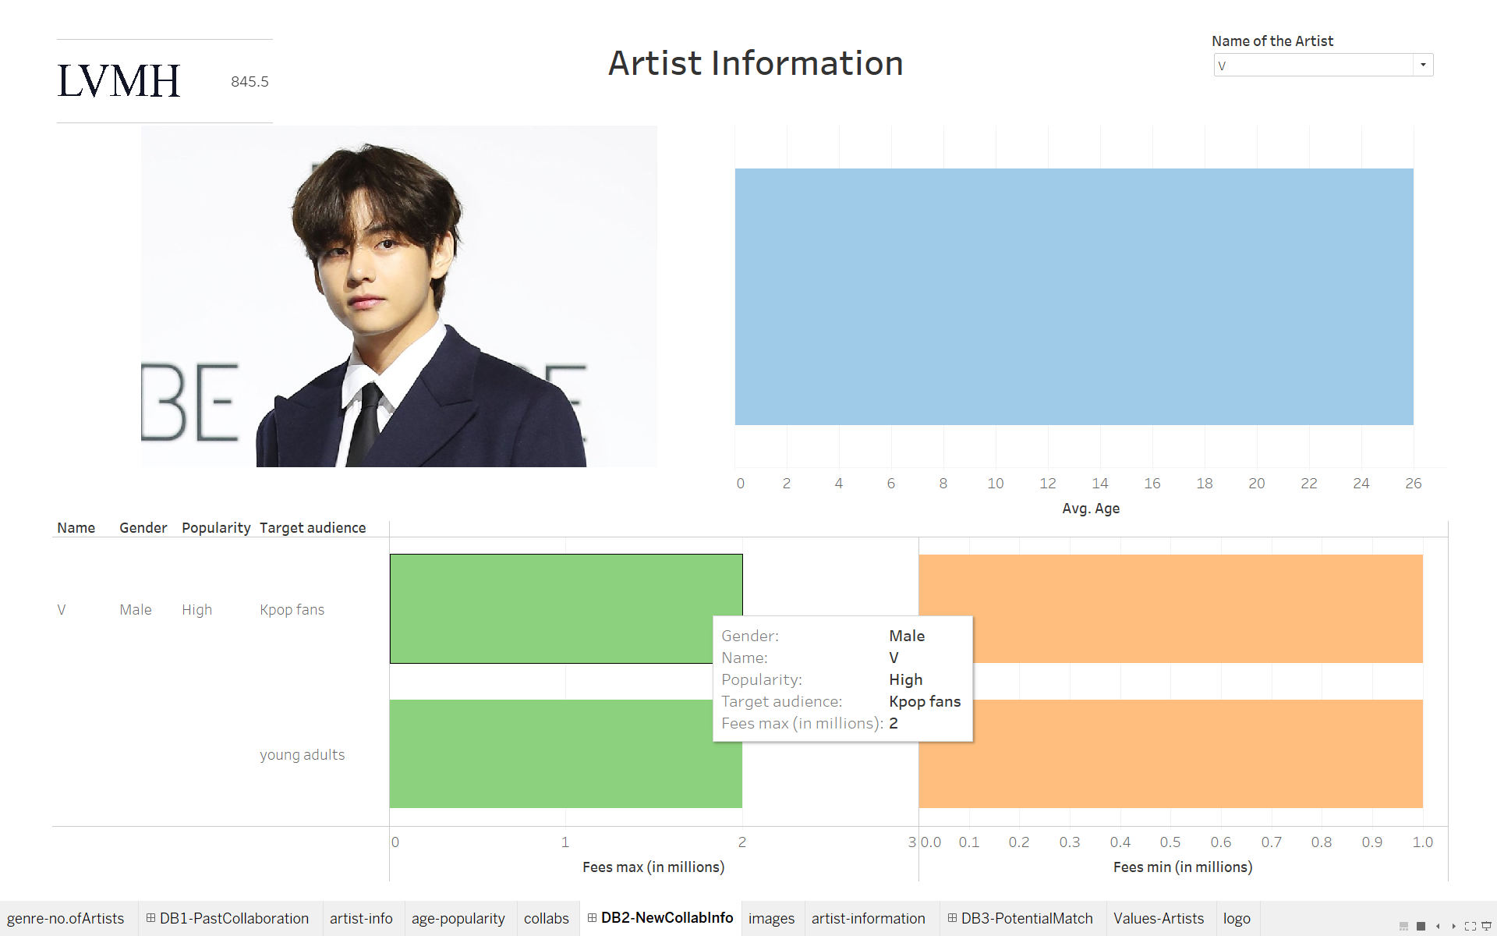
New-to-
the-maison Artists

Slide 8
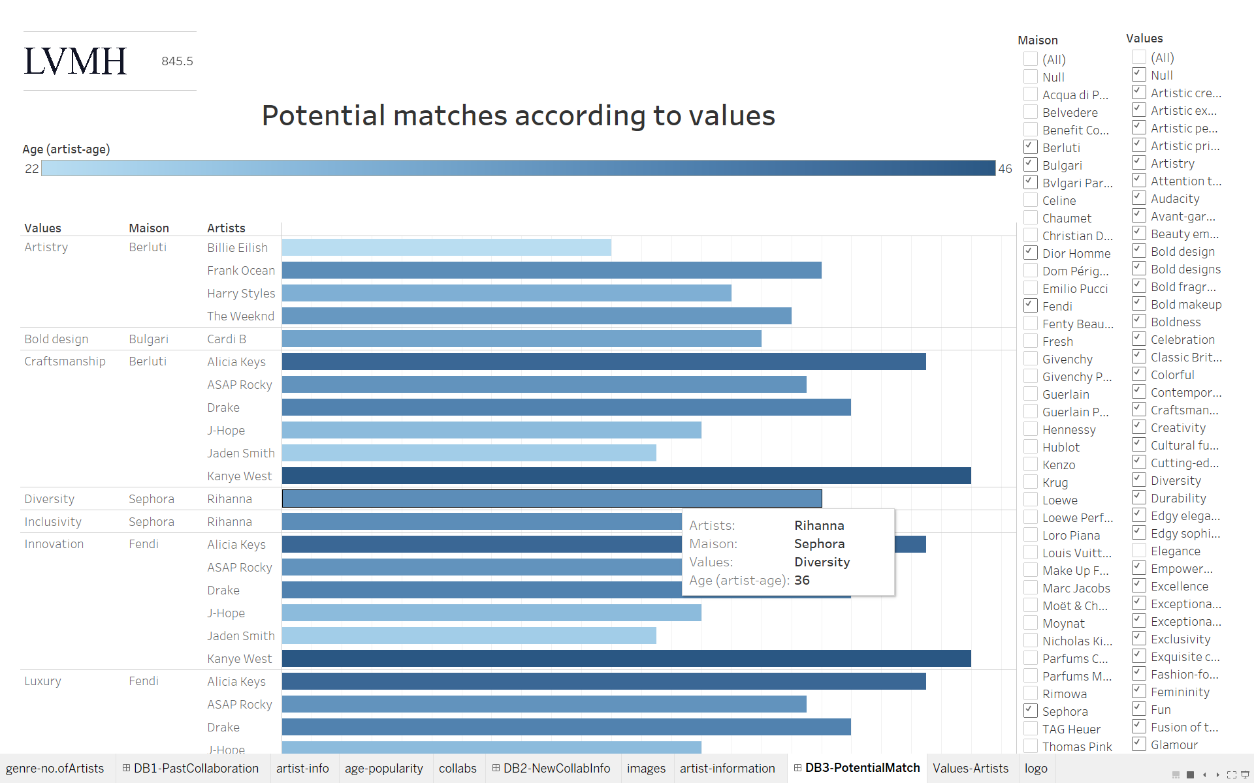
Artist
with specific values

Slide 9
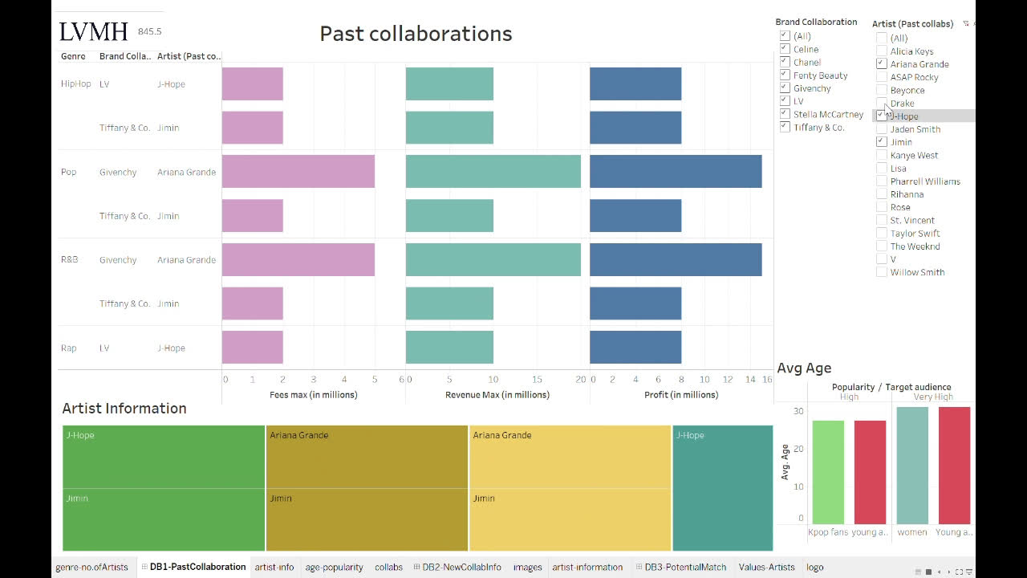
Past collaboration Artists

Slide 10
CONTRACT STAGE
How the process works:
Artist Identification
LVMH House Identification
1
Project Scope
2
Compensation
3
4

Slide 11

Contract Termination
Maturity
Upon successful completion of the project and fulfillment of all obligations, the contract naturally terminates.
Termination for Cause
The contract can be terminated if either party breaches its obligations and fails to rectify

Slide 12
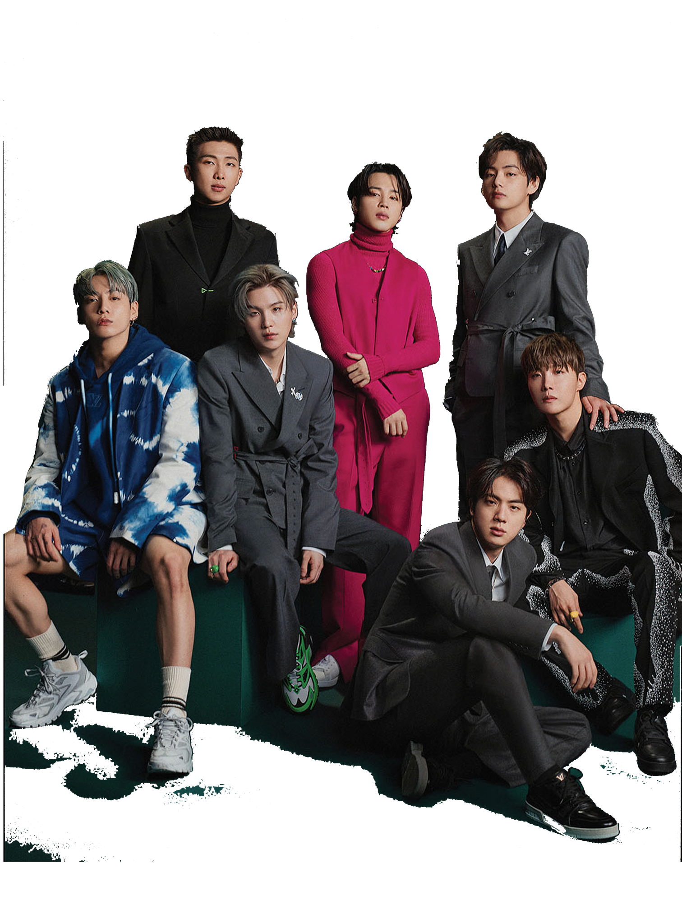
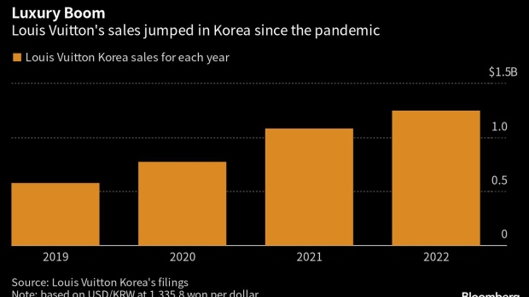
PROBLEM SOLVED!
BTS X LOUIS VUITTON
DANIEL saved time and created an impactful collaboration

Slide 13





MUSEACO
FOR EVERY MANAGER

Slide 14
LVMH
MUSIC X LUXURY COLLABORATIONS
THANK YOU!

